Slide 1




Deciphering the function and evolution of the centromeric repeats in Primates
Sarah Kaddah
M2 BI
19/01/2018
Tuteur: Loic Ponger
Département: Régulation, Développement, Diversité Moléculaire
Unité: Structure et Instabilité des génomes CNRS UMR 7196 / INSERM U1154 / MNHN

Slide 2
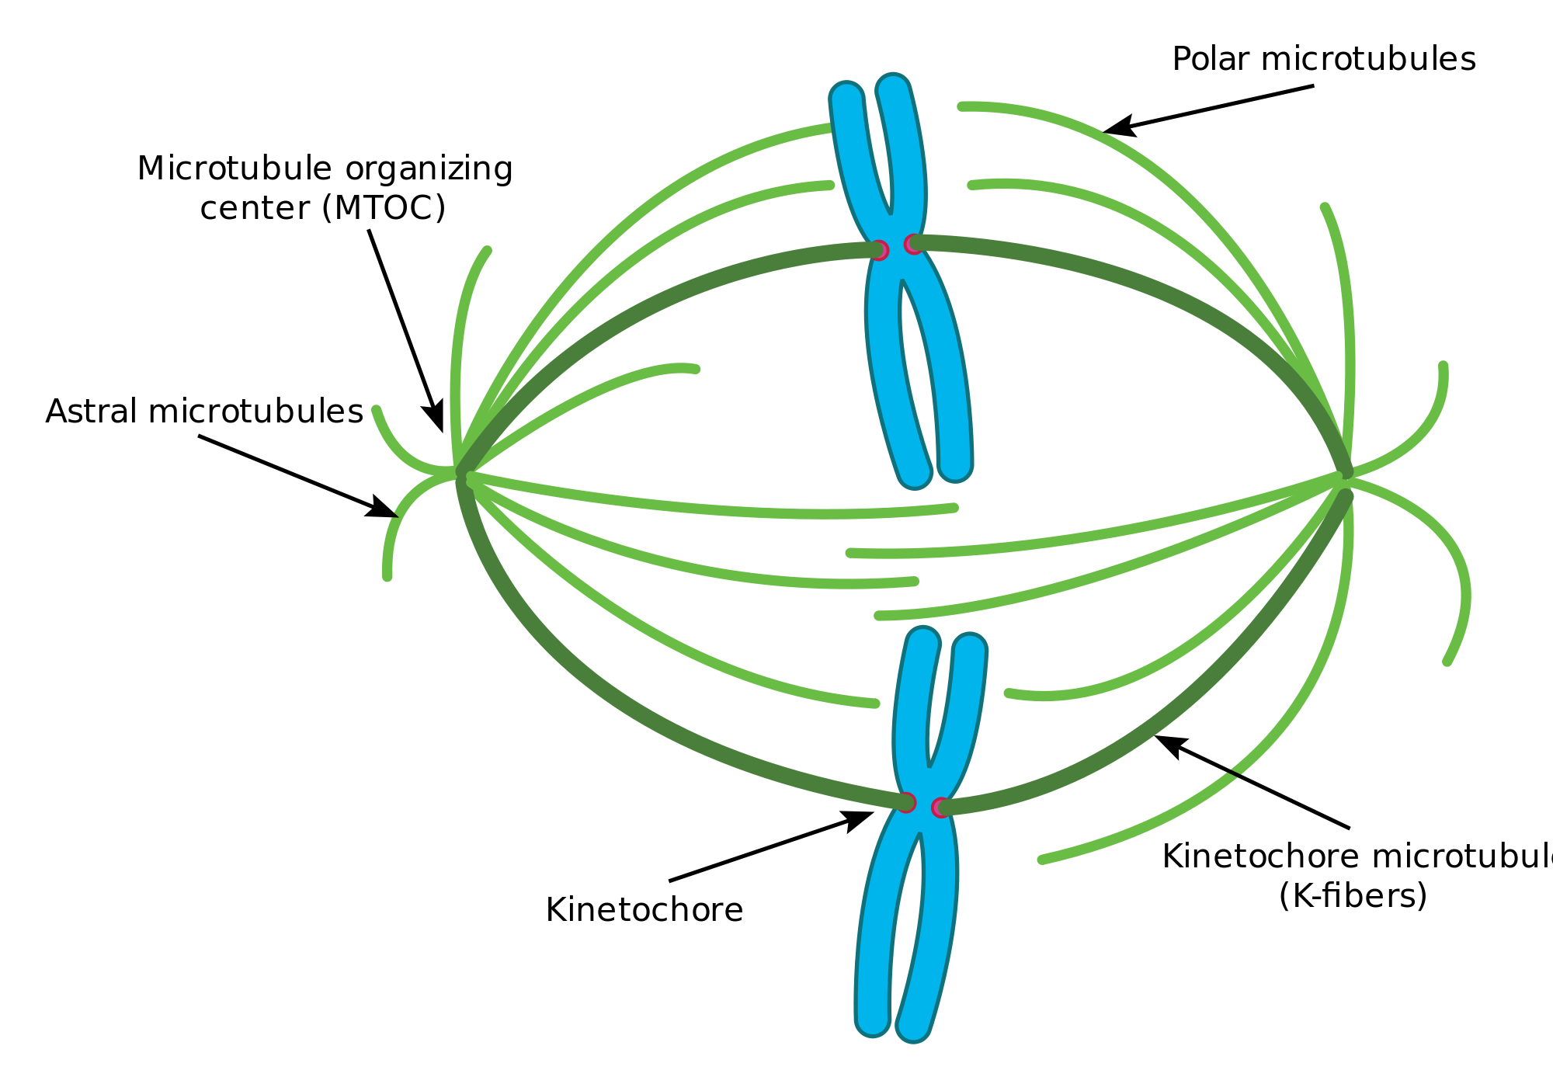
About the centromere
Chromatin structure
Cell division
DNA diverse
Protein involved conserved
Satellite DNA: Tandemly repeated sequence (~100 to +10 000)
Function ? (fixation of proteins …)
Albert et al, 2002

Slide 3
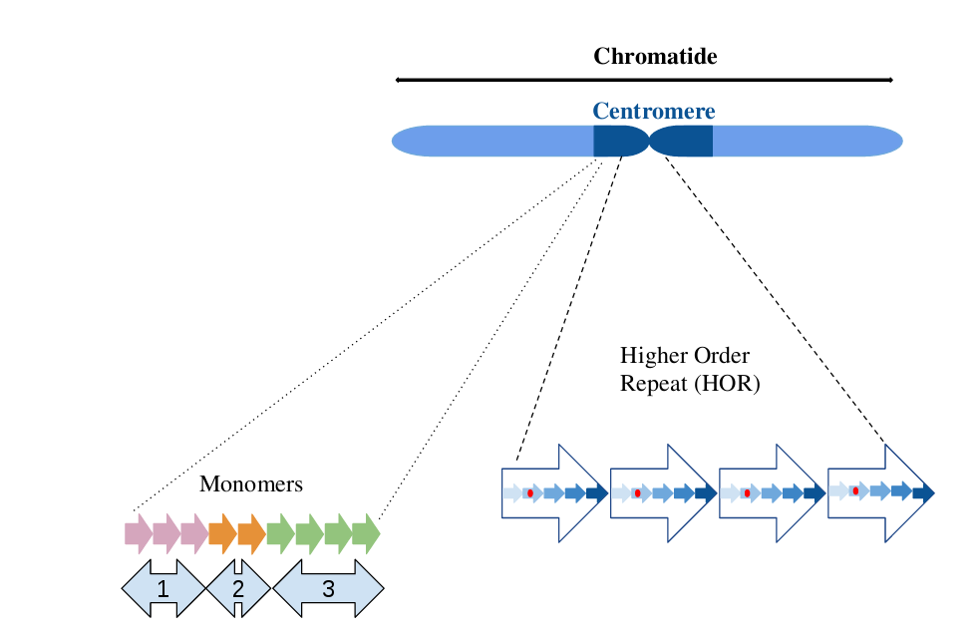
Satellite DNA in Primates
Tandemly repeated sequence: α-satellite
Repeat length ~170 pb
Similarity: more than 70%
Hundreds of thousands repeats
Composed by several families
Specific spatial organisation
Binding sites:
-CENP-B
-pJalpha
Monomeric organization
Binding site

Slide 4
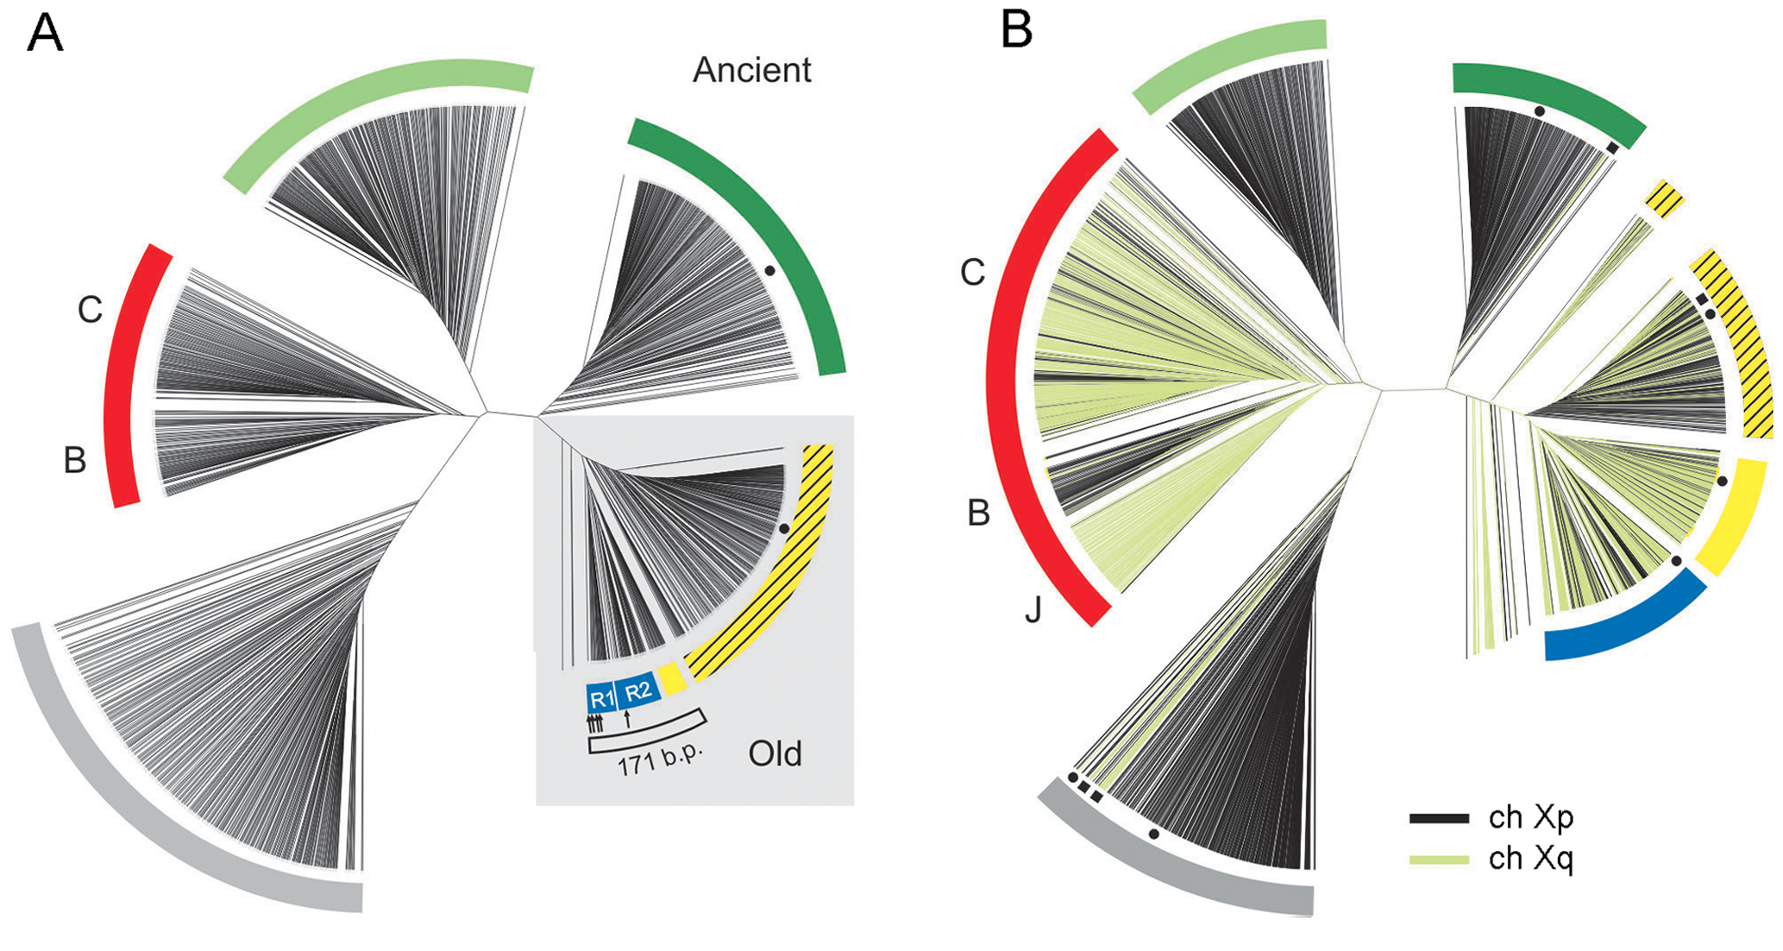
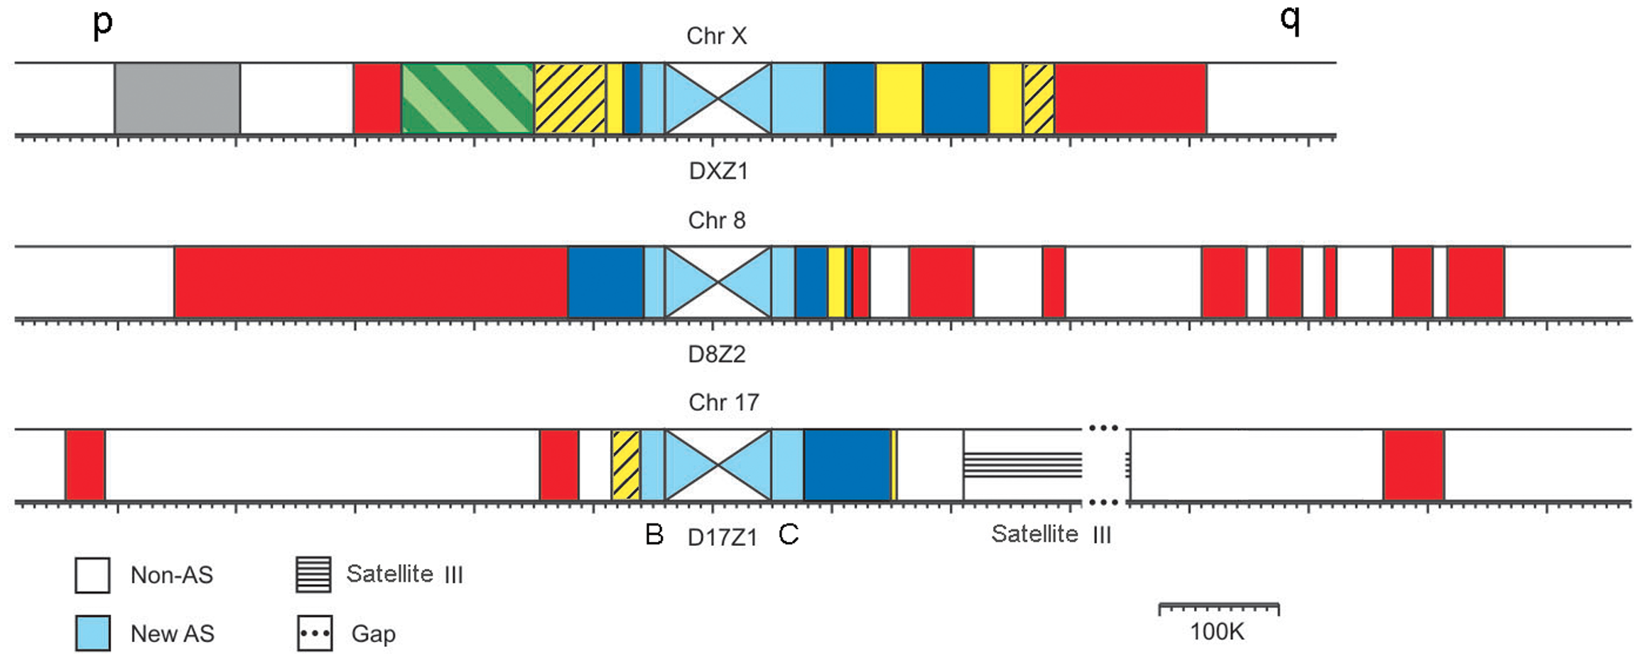
α-satellites DNA
Studies in human:
Phylogenetic analysis of pericentromeric monomers,
Shepelev et al., 2009
Age-gradient hypothesis:
youngest families on centromeric regions
Identification of 20 families
Shepelev et al., 2009

Slide 5
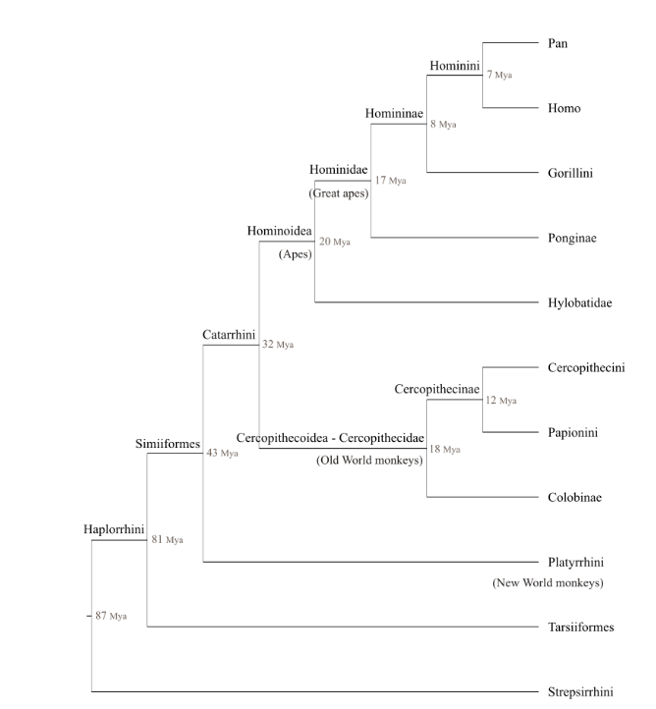
α-satellites DNA
Studies on Gorillas, Catacchio et al., 2015
Medium throughput-sequencing
Identification of 5 families
Complex HOR organization
Binding sites for CENP-B
Studies on Cercopithecini,
Cacheux et al., 2016
High throughput-sequencing
Identification of 6 families
Binding sites for pJalpha
Few interspecific comparison

Slide 6
Goals:
Understand the function and evolutionary mechanisms
of α-satellite DNA

Slide 7
Workplan
1 - Choose species for analysis
1
Janvier
Février
Mars
Avril
Mai
Juin

Slide 8
Workplan
1 - Choose species for analysis: several (~3) out of 16
Species | Alpha- Satellite Number
Cercocebus atys (SRA) | 80 884
Chlorocebus sabaeus | 29 842
Gorilla gorilla | 120 864
Homo sapiens (HGSC, HuRef) | 37 204 ; 63 167
Macaca fascicularis (genome and SRA) | 195642 ; 39893
Macaca mulatta (SRA) | 7 365
Macaca nemestrina (SRA) | 462 063
... | ...
1
Janvier
Février
Mars
Avril
Mai
Juin

Slide 9
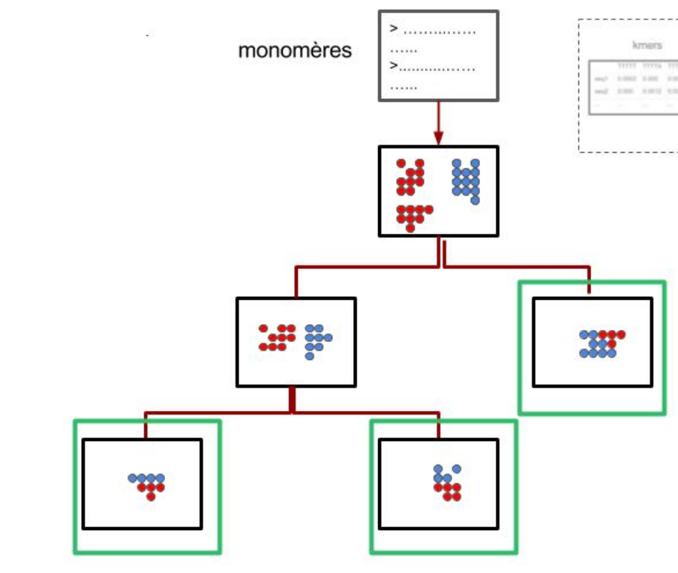

Workplan
1 - Choose species for analysis
2 - Identify families for each species :
objective and reproducible method
Process big amount of short sequences
Classification into families
Binary classification
1
2
Janvier
Février
Mars
Avril
Mai
Juin
19/02

Slide 10
Workplan
1 - Choose species for analysis
2 - Identify families for each species
3 - Characterize families into each species:
-percentage of similarity
-binding sites...
1
2
3
Janvier
Février
Mars
Avril
Mai
Juin

Slide 11
Workplan
1 - Choose species for analysis
2 - Identify families for each species
3 - Characterize families into each species
4 -1. Interspecific comparison
4 -2. Spatial organization analysis (HOR)
1
2
3
4
Janvier
Février
Mars
Avril
Mai
Juin
12/04

Slide 12
Workplan
1 - Choose species for analysis
2 - Identify families for each species
3 - Characterize families into each species
4 -1. Interspecific comparison
4 -2. Spatial organization analysis (HOR)
5 - Writing of the report
1
2
3
4
5
Janvier
Février
Mars
Avril
Mai
Juin
14/06 ; 18/06 ; 27/06

Slide 13
Thank you for your attention

Slide 14
Data
Espèces | Nombre de séquences
Cercocebus atys (SRA) | 80 884
Chlorocebus sabaeus | 29 842
Gorilla gorilla | 120 864
Homo sapiens (HGSC, HuRef) | 37 204 ; 63 167
Macaca fascicularis (genome, SRA) | 195642 ; 39893
Macaca mulatta (SRA) | 7 365
Macaca nemestrina (SRA) | 462 063
Mandrillus leucophaeus (WGS) | 34 140
Nasalis larvatus | 21 399
Nomascus leucogenys | 392 948
Pan paniscus (SRA) | 272 661
Pan troglodytes | 114 104
Papio anubis | 515 969
Papio hamadryas (Contigs) | 70188
Pongo_abelii ( genome, NCBI) | 173 428 ; 175 240
Rhinopithecus_roxellana | 109 811

Slide 15
Algorithm
3 families

